Slide 1
Linking the Security System to Other Data

Slide 2
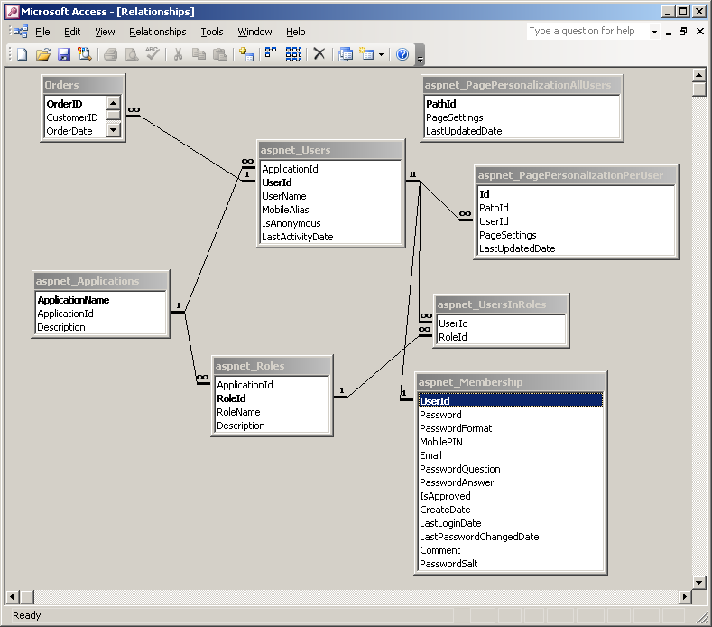
Example

Slide 3
Accessing the Logged-In User Name
On Page_Load it is possible to access the name of the logged in user and place it in a text box or session variable:
protected void Page_Load(object sender, EventArgs e)
{
tbUserName.Text = System.Web.HttpContext.Current.User.Identity.Name;
Session["UserName"] = System.Web.HttpContext.Current.User.Identity.Name;
}
Or, if the System.Web namespace is referenced,
tbUserName.Text = User.Identity.Name;
Session["UserName"] = User.Identity.Name;

Slide 4
More detail
protected void Page_Load(object sender, EventArgs e)
{
if (User.Identity.IsAuthenticated)
{
tbUserName.Text = User.Identity.Name;
Page.Title = "Home page for " + User.Identity.Name ;
}
else
{
tbUserName.Text = "Not applicable"
Page.Title = "Home page for guest user";
}

Slide 5
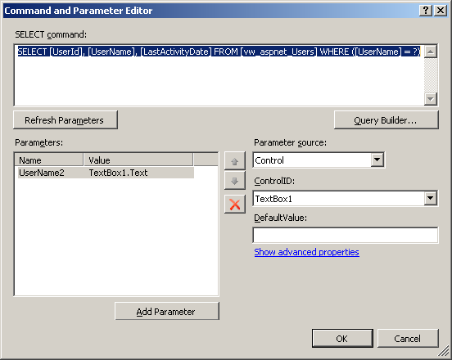
Accessing other fields

Slide 6
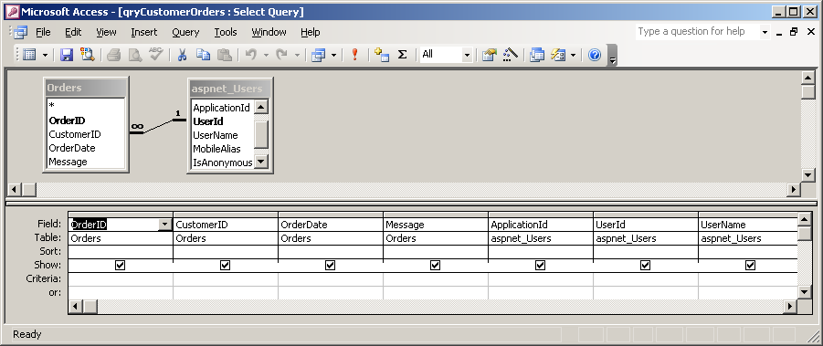
Accessing data from linked tables
SELECT Orders.OrderID, Orders.CustomerID, Orders.OrderDate, Orders.Message, aspnet_Users.ApplicationId, aspnet_Users.UserId, aspnet_Users.UserName
FROM aspnet_Users INNER JOIN Orders ON aspnet_Users.UserId = Orders.CustomerID;

Slide 7
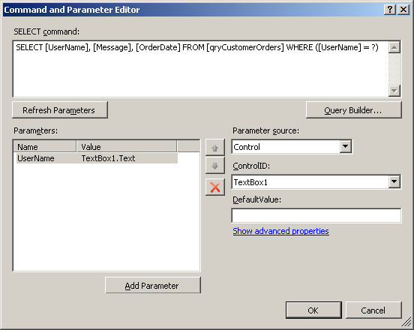
Using the Query

Slide 8
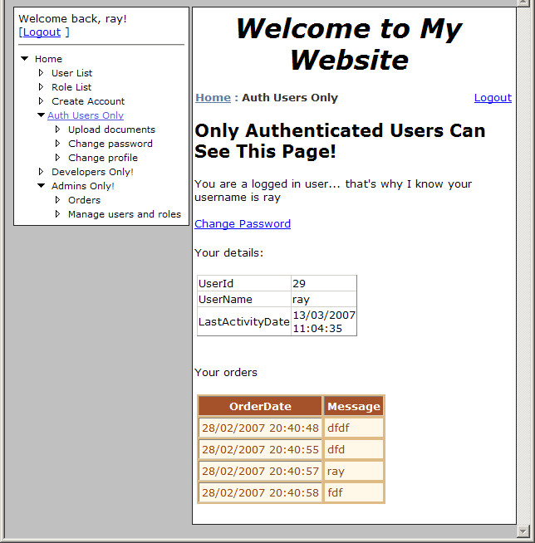
To give

Slide 9
And so on …

